Slide 1
HTML Structure & syntax

Slide 2
Introduction
This presentation introduces the following:
Doctype declaration
HTML Tags, Elements and Attributes
Sections of a Web document
Role of Web browser
Text editor
Saving and previewing files
Notes:
Html 5

Slide 3
World wide web consortium
HTML5 is a cooperation between the World Wide Web Consortium (W3C) and the Web Hypertext Application Technology Working Group (WHATWG).

Slide 4
Doctype declaration
In HTML5 there is only one <!doctype> declaration, and it is very simple: <!DOCTYPE html>
The doctype is not an HTML tag. It is a declaration. It tells the browser the version of HTML.

Slide 5
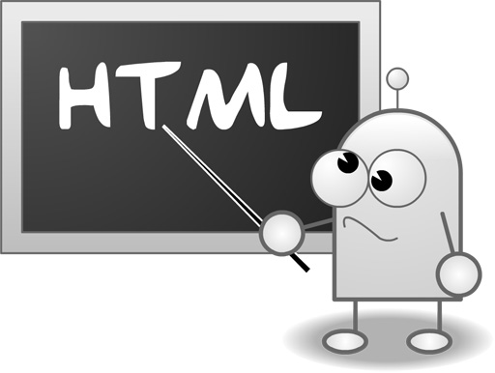
What is html?
HTML stands for Hyper Text Markup Language
HTML is a markup language
A markup language is a set of markup tags
The tags describe document content
HTML documents contain HTML tags and plain text
HTML documents are also called web pages

Slide 6
What are html tags?
HTML tags are keywords (tag names) surrounded by angle brackets like <html>
HTML tags normally come in pairs like <b> and </b>
The first tag in a pair is the start tag, the second tag is the end tag
The end tag is written like the start tag, with a forward slash before the tag name
Start and end tags are also called opening tags and closing tags

Slide 7
What is an html element?
An HTML element is everything between the start tag and the end tag, including the tags:
HTML Element:
<p>This is a paragraph.</p>

Slide 8
What is an attribute?
Attributes provide additional information about an element.

Slide 9
Minimum html document
<!DOCTYPE html> <html> <head> <meta charset="UTF-8"> <title>Title of the document</title> </head> <body> Content of the document...... </body> </html>

Slide 10
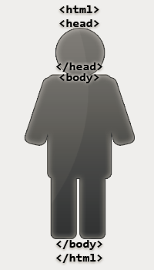
Two sections in a web page
The <head> section contains information about your page.
The <body> section contains the visible content of your page.

Slide 11
Web browser
The purpose of a web browser (such as Google Chrome, Internet Explorer, Firefox, Safari) is to read HTML documents and display them as web pages.
The browser does not display the HTML tags, but uses the tags to determine how the content of the HTML page is to be presented/displayed to the user.

Slide 12
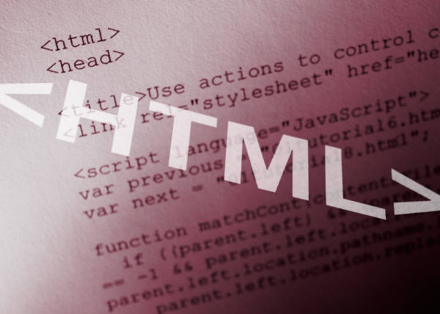
Writing html code
A simple text editor can be used for coding a Web page.
Using a text editor is a good way to learn coding.
Web editors are also used for coding.
Notes:
There are a variety of tools available for creating a Web page. These tools include web editors (such as Dreamweaver) to website builders to WordPress themes. There are free tools and expensive tools. Websites can be built with little actual HTML knowledge.

Slide 13
Saving a file
When you save an HTML file, you can use either the .htm or the .html file extension. There is no difference, it is entirely up to you.
Save the file in a folder that is easy to remember
Keep filenames short and descriptive.
Avoid using spaces in filenames.
Notes:
Show students URLs and discuss how the path identifies the location of a document

Slide 14
Previewing the file
Open the HTML page in a Web browser to preview it.
You should view your page in multiple Web browsers. Most likely it will not look exactly the same in every Web browser.
Notes:
Once the document is saved as .htm or .html it will associate with the default web browser

Slide 15
Next step…..
Learn some codes.
Notes:
At this point you may want to go to http://w3schools.com and use the tutorials or the TryIt editors

