Slide 1
1.00 Apply procedures to set project requirements in Dreamweaver. (10%)

Slide 2
Project Management
Beginning a digital media project from scratch and carrying it through to its final completion takes a unified effort from all parties involved.
Creating a Project Plan helps the process move forward quickly and efficiently. It helps the team avoid:
mistakes
arguments
tension within the team
wasted time

Slide 3
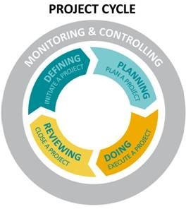
Project Management
Four stages in project management process:
Defining
Planning
Doing
Reviewing

Slide 4
Defining
Defining a project is the opportunity to establish its elements and boundaries, so that the size and shape of the project and its outcomes are all understood and agreed upon before beginning work.

Slide 5
Defining
Some of the questions addressed include:
What do you do first?
What should come next?
Who will complete each task?
What resources do you need?
How long will it take?
When will the project be finished?
How will we know we are done with the project?

Slide 6
Defining
Identify the following things:
Project objectives
Target audience
Goals
Sub-phases
Tasks
Resources
Budget
Schedule

Slide 7
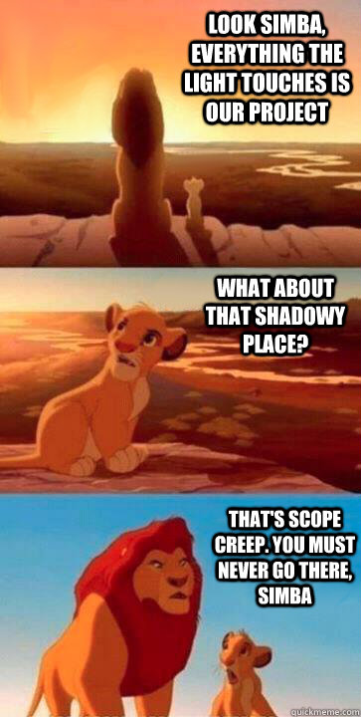
Defining: Project Scope
Scope Creep
Incremental expansion of the project scope.
Introducing features not originally planned.
Delays project and adds cost.

Slide 8
Defining: Flow Chart
Objective ____ or Task ____
Steps to complete
Write Materials on the sides.

Slide 9
Defining: Schedule

Slide 10
Planning
Planning is an important step because the amount of time and energy dedicated to planning will correlate directly to how well the project stays on schedule, on budget, and how well it meets its goals.
File requirements
File management
Color scheme
Typography
Logos/images created or located
Script/Storyboard/Mock Layout created

Slide 11
Doing
The core of the project is doing, the execution—the implementation of the plans. In order to accomplish their goals, members will be monitoring their work, collaborating with team members, assessing their progress, and revising their project plans as necessary.
Create needed project elements
Compile and edit project
Monitor schedule and task completion

Slide 12
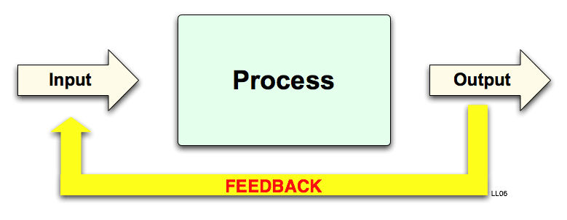
Reviewing
Reviewing is the opportunity to focus on the effectiveness of the team’s processes and the quality of the project deliverables. In this final stage, the focus is on assessing and celebrating the achievements of the entire project.
Preview proofs
Revise based on feedback
Optimize files
Publish in final format

Slide 13
Website Accessibility
Accessibility is making websites functional for people with visual, auditory, motor, and other disabilities.
Accessibility features for websites include screen reader support, text equivalents for graphics, keyboard shortcuts, and change of display colors to high contrast.

Slide 14
Website Accessibility
A screen reader recites text that appears on the computer screen.
It also reads non-textual information, such as button labels or image descriptions, provided during designing.
Dreamweaver dialog boxes prompt you to enter accessibility attributes—such as text equivalents for an image—when you insert page elements.

Slide 15
Legal Terms in Digital Media
Intellectual Property
Original creations of the mind that can be protected by law; literary and artistic works, designs, symbols, images, names, etc.
Copyright
The exclusive legal right to reproduce, publish, sell or distribute the expression of an intellectual property (literature, design, audio, video, etc.)

Slide 16
Legal Terms in Digital Media
Trademark
A mark (logo, symbol, word, phrase, etc.) legally registered or established by a company to represent a service or product; cannot be used without the permission of the owner.
Fair Use
A legal allowance of using a copyrighted material without permission from the owner, provided the circumstances are reasonable and do not make the material less profitable.

Slide 17
Creative Commons
A nonprofit organization that enables the sharing and use of creativity and knowledge through free legal tools.
Free, easy-to-use copyright licenses provide a simple, standardized way to give the public permission to share and use your creative work — on conditions of your choice.
Creative Commons licenses are not an alternative to copyright. They work alongside copyright and enable you to modify your copyright terms to best suit your needs.

Slide 18
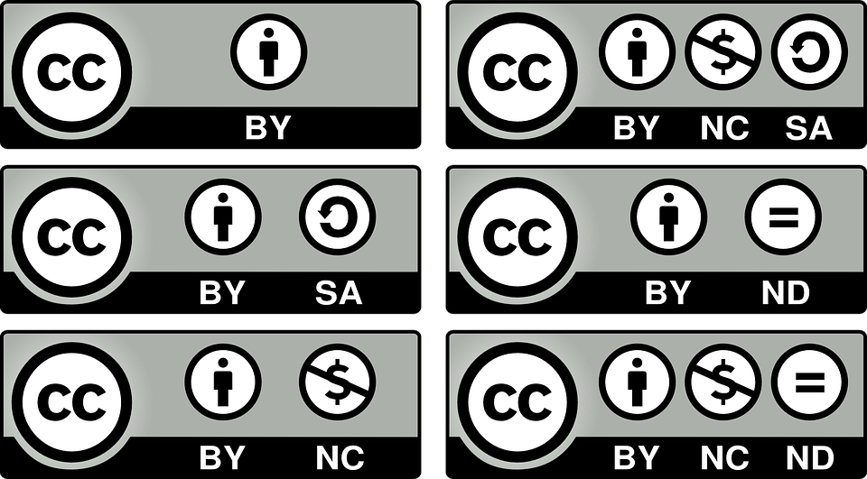
Creative Commons
Creative Commons Video
Creative Commons Licenses
Six types with different features

