Slide 1
3.00 Understanding the Adobe Dreamweaver interface. (12%)

Slide 2
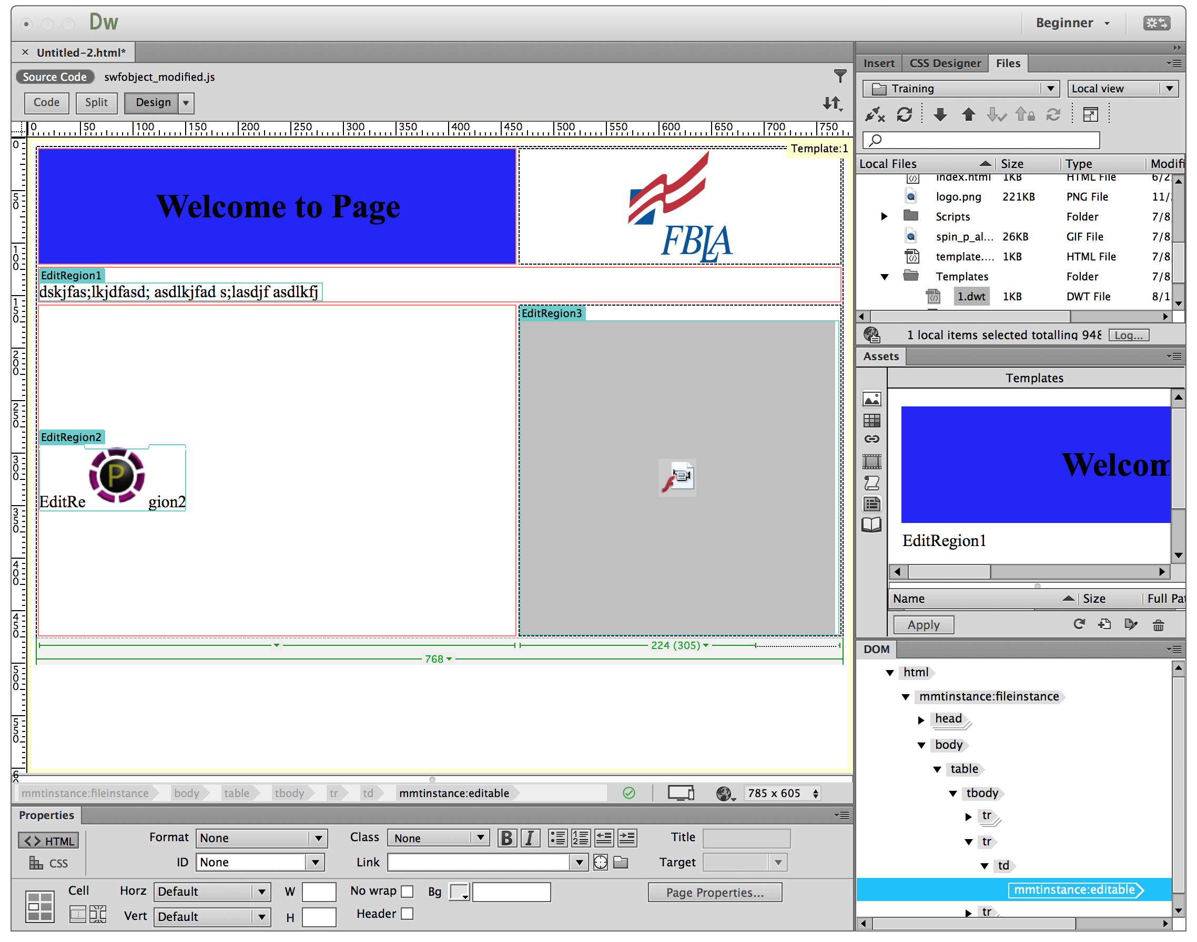
Dreamweaver Interface

Slide 3
Panels in Design View
Design Panel
Code View
Split View
Files Panel
Insert Panel
Property Inspector

Slide 4
Design Panel
Design view is a WYSIWYG interface.
Add content and the code is written automatically.

Slide 5
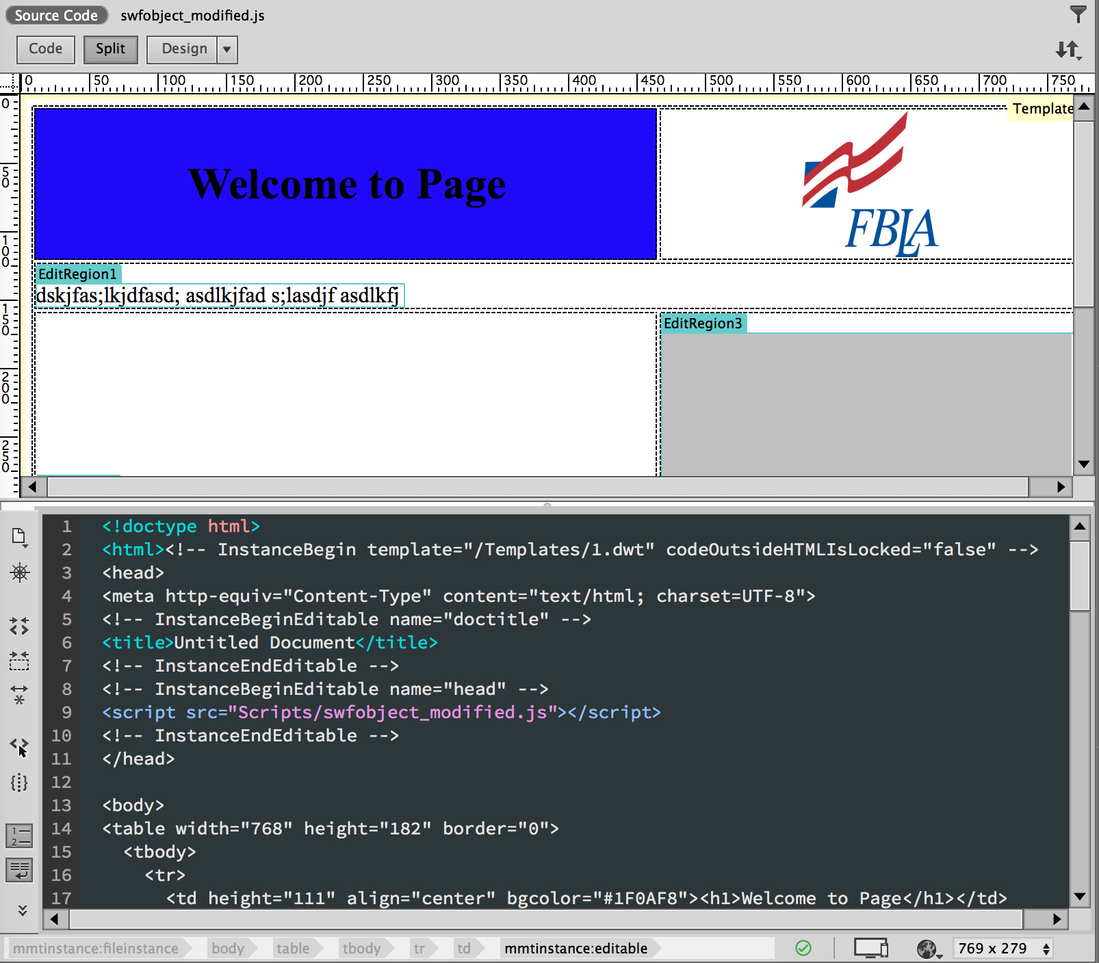
Code vs. Split View
Code view can see and write code.
Split view can see design and code views. Can edit in either area.

Slide 6
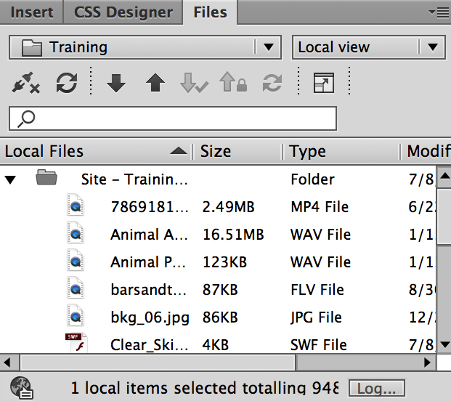
Files Panel
Enables you to view files and folders, whether they are associated with a Dreamweaver site or not.
Perform standard file maintenance operations, such as opening and moving files.

Slide 7
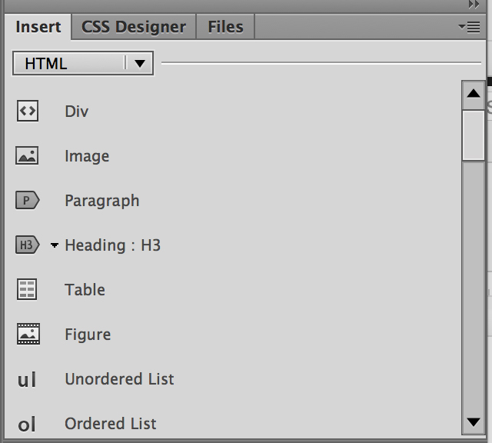
Insert Panel
Contains buttons for creating and inserting objects such as tables and images.
The buttons are organized into categories.

Slide 8
Properties Inspector
Lets you examine and edit the most common properties for the currently selected page element, such as text or an inserted object.
The contents of the Property inspector vary depending on the element(s) selected.

Slide 9
Customize Workspace
Your Dreamweaver workspace can be changed to best meet your needs as a designer.
Change document views
Rearrange/resize windows and panels
Add or remove tools on toolbar
Create and save custom workspace
These same techniques can be used to customize other Adobe software.

