Slide 1
Objective 103.03 4% Utilize appropriate tools and methods to produce digital animation.

Slide 2
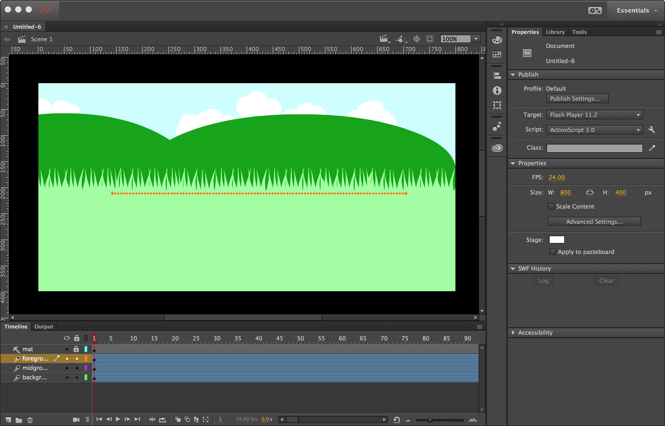
Animate Workspace

Slide 3
Panels in Animate Workspace
Stage
Timeline
Properties Panel
Library Panel
Tools Panel

Slide 4
Stage
The rectangular area where you place graphic content when creating Animate documents.
To change the view of the Stage as you work, zoom in and out.
To help you position items on the Stage, you can use the grid, guides, and rulers.

Slide 5
Timeline
Defaults to only one layer.
To organize artwork and animation add more layers.
You can also hide, lock, or rearrange layers.
Each layer is made up of frames.
Timeline Video

Slide 6
Properties Panel
Provides easy access to properties of the current selection, either on the Stage or in the Timeline.

Slide 7
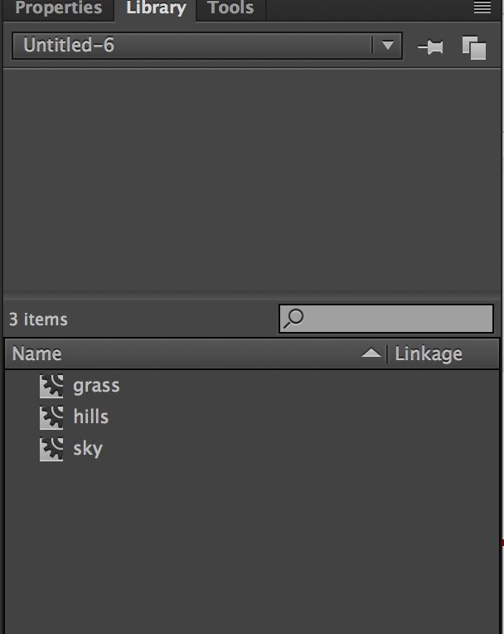
Library Panel
Where symbols are stored and organized in Animate.
Includes those created in Animate as well as imported files, including bitmap graphics, sound files, and video clips.

Slide 8
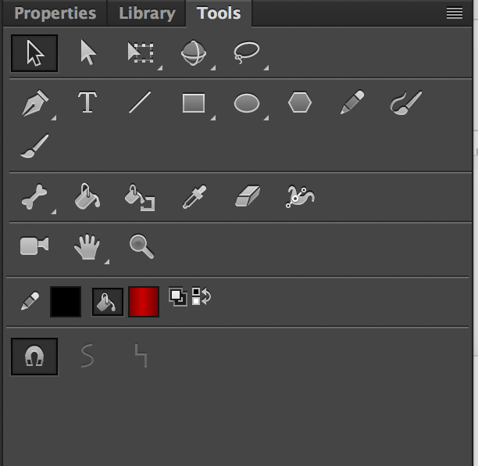
Tools Panel
The Tools panel is divided into four sections:
The tools area with drawing, painting, and selection tools.
The view area for zooming and panning.
The colors area for changing fill and stroke.
The options area contains attributes for the currently selected tool.

Slide 9
Customize Workspace
Your Animate workspace can be changed to best meet your needs as a video editor.
Change document views
Rearrange/resize windows and panels
Add or remove tools on toolbar
Create and save custom workspace
These same techniques can be used to customize other Adobe software.

Slide 10
ActionScript 3 vs. HTML5
Action Script 3 is the programming language for the Adobe Flash/Animate projects.
Web browsers cannot render Flash media without the plugin, Flash Player.
HTML5 can be used as an alternative to Flash media (so Flash Player is not required).
Both include features for playing audio and video within web pages, play some basic HTML5 browser games and use integrated vector graphics.

Slide 11
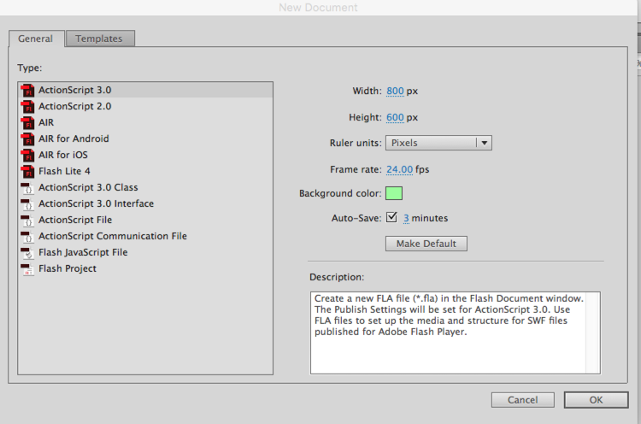
Starting a New Project
Common tips for beginning an animation:
Use ActionScript 3 for most animations.
Set stage size to match final output size.
Check frame rate.
Select background first.
Auto Save is helpful.

Slide 12
Tweens
Motion Tween - Most common type of movement. Objects (as symbols) can change position, rotation, alpha and size.
Shape Tween - Objects can morph from one shape or color to another shape or color as defined by keyframes
Classic Tween - Older way to animate, great for simple movement.

Slide 13
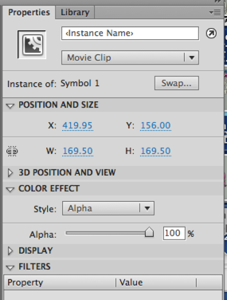
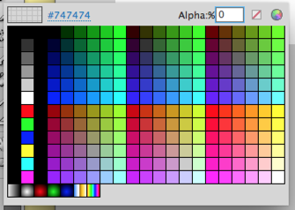
Alpha Adjustments
Transparency can be done in the properties panel or in the color palette.
Normally used to make an object gradually fade in or fade out.

Slide 14
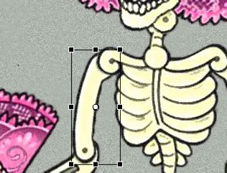
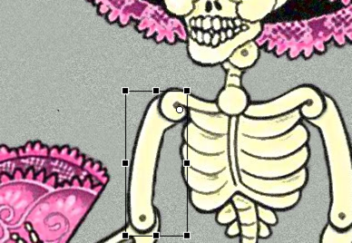
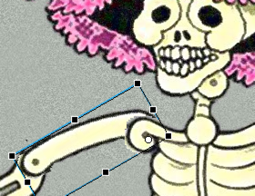
Anchor Point Adjustments
Anchor Point
Rotation axis of an object.
Use anchor point to set where movement should occur.
Pivot Points start in the center
Move pivot to new rotation point
Makes movement more natural

